Slide 1
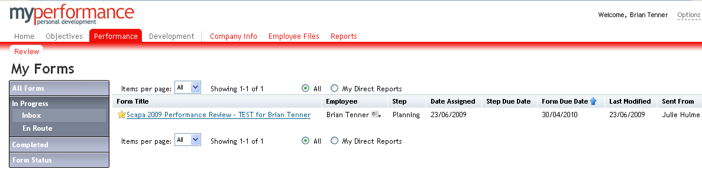
Planning Step – How to agree objectives with your Manager
My Forms stores current and archived forms centrally. You can access forms and track the status of forms. The shaded area indicates the ‘current’ location which is ‘Inbox’
Click here to access your
Performance Management Form. Forms received from your team that require action will also be located here

Slide 2
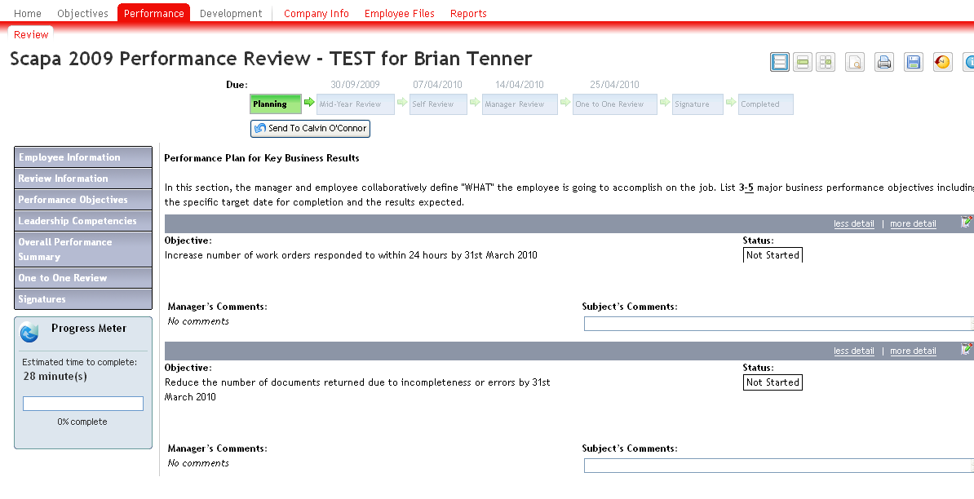
Planning Step - Performance Review Form
Click here to send your objectives to your Manager to initiate workflow and gain agreement
Hover over specific icon to see explanation
Specific sections of the Performance Review Form that must be completed
Workflow – current stage highlighted in green
Objectives created in the Objectives Tab are automatically updated into the Performance review Tab.
Click save and close at the bottom of the form

Slide 3
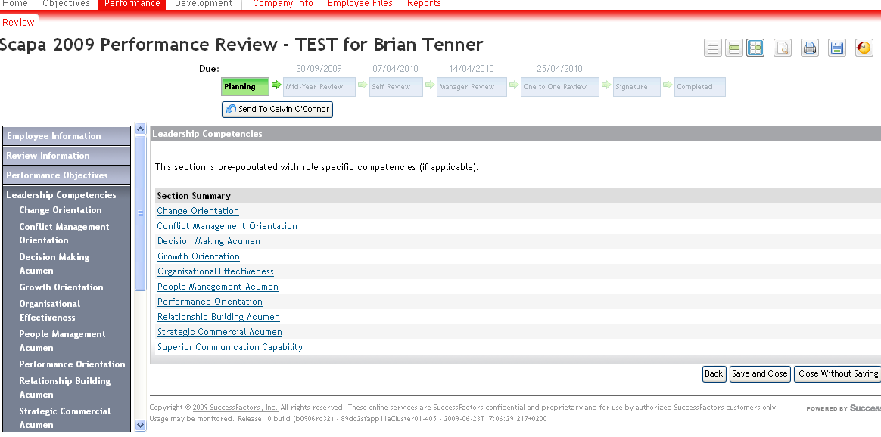
Planning Step – Leadership Competencies Section
Leadership Competencies related to your job role and those defined in your 360 feedback
No action is required at the Planning step

Slide 4
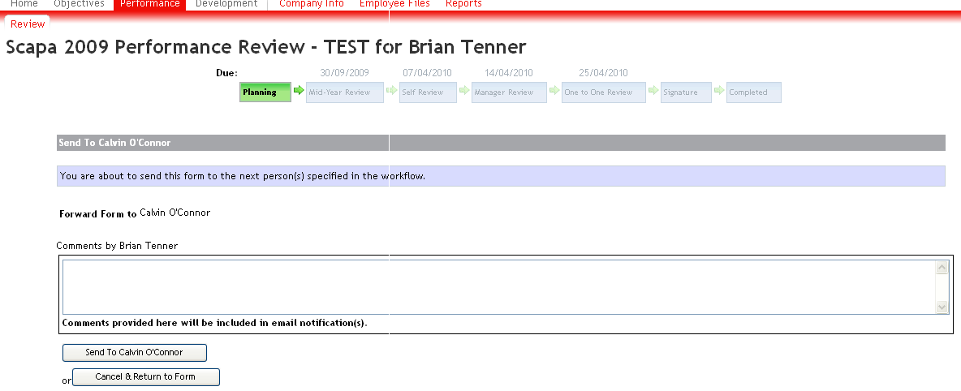
Planning Step – How to agree objectives with your Manager
Any comments can be included here for review by your manager when sending to manager
Click here to send form to your manager

Slide 5
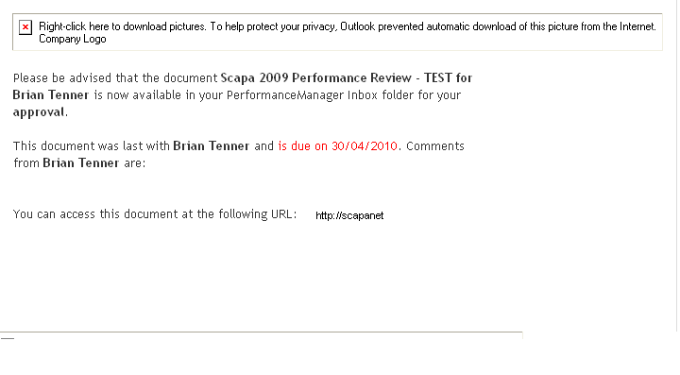
Automatic Email Notification – received by Manager
Click here to take you to the ‘My Performance’ icon and locate the Performance review form
Email received by Manager prompting action to be taken

Slide 6
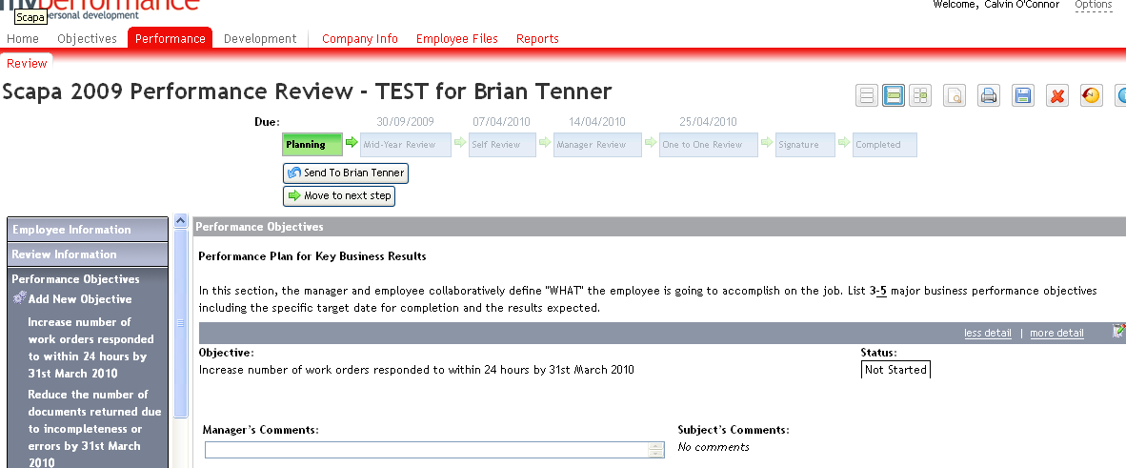
Planning Step - How to agree objectives with your Manager
Once you have agreed on the objectives, your manager will move the Performance Review Form to the next step by clicking here
The form is automatically routed to your managers inbox for review and agreement

Slide 7
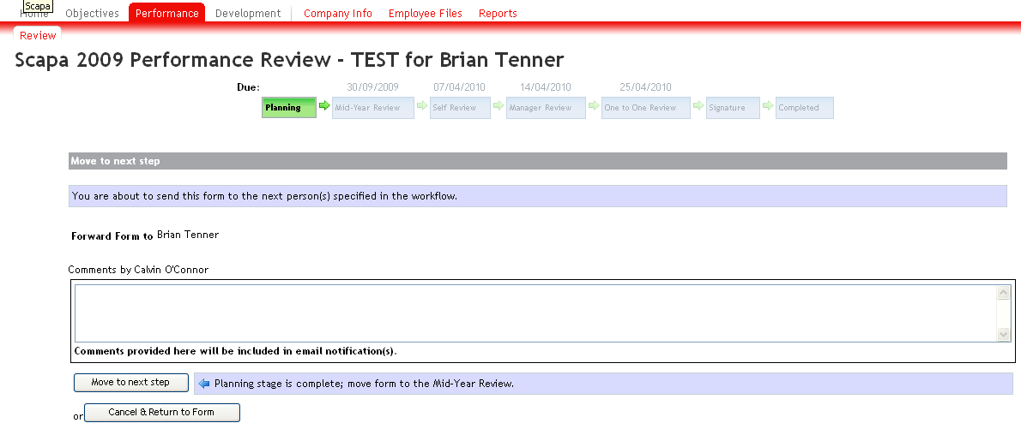
Planning Step – How to agree objectives with your Manager
Manager will click here to move the form to the next step. Form will appear in the Employee ‘In box’

Slide 8
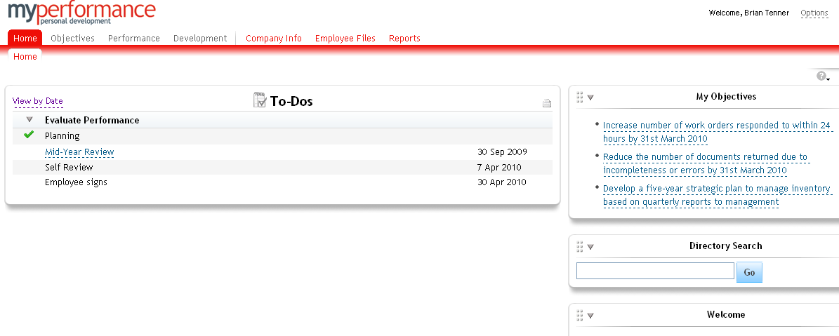
Planning Step Completed - Home Tab
Planning step is now complete – indicated by the green tick
Objectives have been automatically populated into the employee Home page. Creates a quick easy reference

